Slide 1



Breast Cancer Prediction Using Supervised Learning
Student Name : Mariem Hamam
Manar Mohamed
Malak Nabawy
Under Supervision :Dr.Reham Abobeah & Eng Esraa
This Photo by Unknown Author is licensed under CC BY

Slide 2

Project Overview
This project aims to develop a robust Machine Learning model for predicting breast cancer using the Breast Cancer Wisconsin Dataset.
Through supervised learning methods, the system analyzes clinical cell-level features to classify tumors as benign or malignant.
Multiple models—including Logistic Regression, SVM, and Random Forest—were trained and tested to determine the best-performing algorithm.
The goal is to support early diagnosis, improve accuracy, and assist healthcare professionals.

Slide 3

Problem Definition
Breast cancer diagnosis relies on analyzing microscopic cell features, which may appear visually similar in benign and malignant cases.
This increases the risk of misclassification and delays in treatment.
The problem is to develop a reliable machine learning model that can distinguish tumor types based on measurable features, helping clinicians make faster and more accurate decisions.
This Photo by Unknown Author is licensed under CC BY

Slide 4

Dataset Description
Source:
Included in scikit-learn (load_breast_cancer).
Also available as a CSV on Kaggle .
Size:
569samples (rows).
30 numerical features.
Single binary target variable: Diagnosis.
Target Details:
Two classes: Malignant and Benign.
Represented as a binary label (encode as 0/1 as appropriate
Why this dataset?
Widely used benchmark in medical ML research.
Clean and well-structured — ideal for supervised classification tasks.
Enables comparison across multiple models and evaluation metric
This Photo by Unknown Author is licensed under CC BY-SA

Slide 5
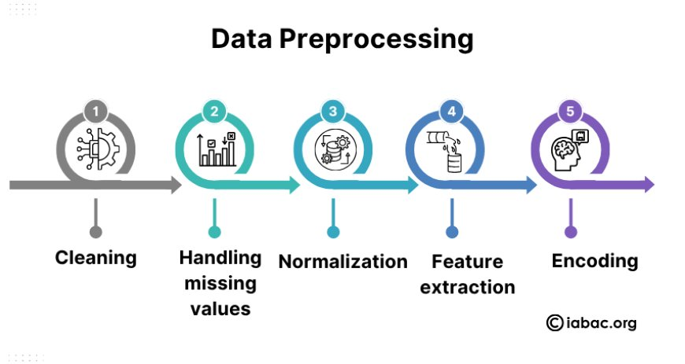
Cleaning + Encoding
Feature Scaling
Train-Test Split
This Photo by Unknown Author is licensed under CC BY-SA

Slide 6
Models Used
This Photo by Unknown Author is licensed under CC BY-SA
Logistic Regression
A linear classification model that predicts the probability of a tumor being malignant or benign. Works best for linearly separable data and provides interpretable decision boundaries.
Support Vector Machine (SVM)
A powerful classifier that finds the optimal hyperplane separating the classes. It is effective in high-dimensional spaces and performs well with complex boundaries using kernels.
Random Forest
An ensemble model that combines multiple decision trees to improve accuracy and reduce overfitting. It provides strong predictive performance and measures feature importance

Slide 7
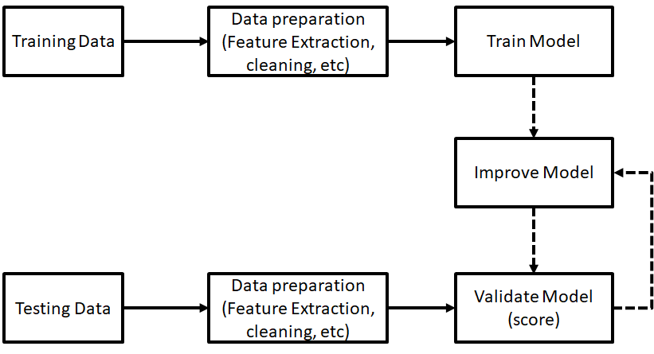
Training & Testing
This Photo by Unknown Author is licensed under CC BY-SA

Slide 8
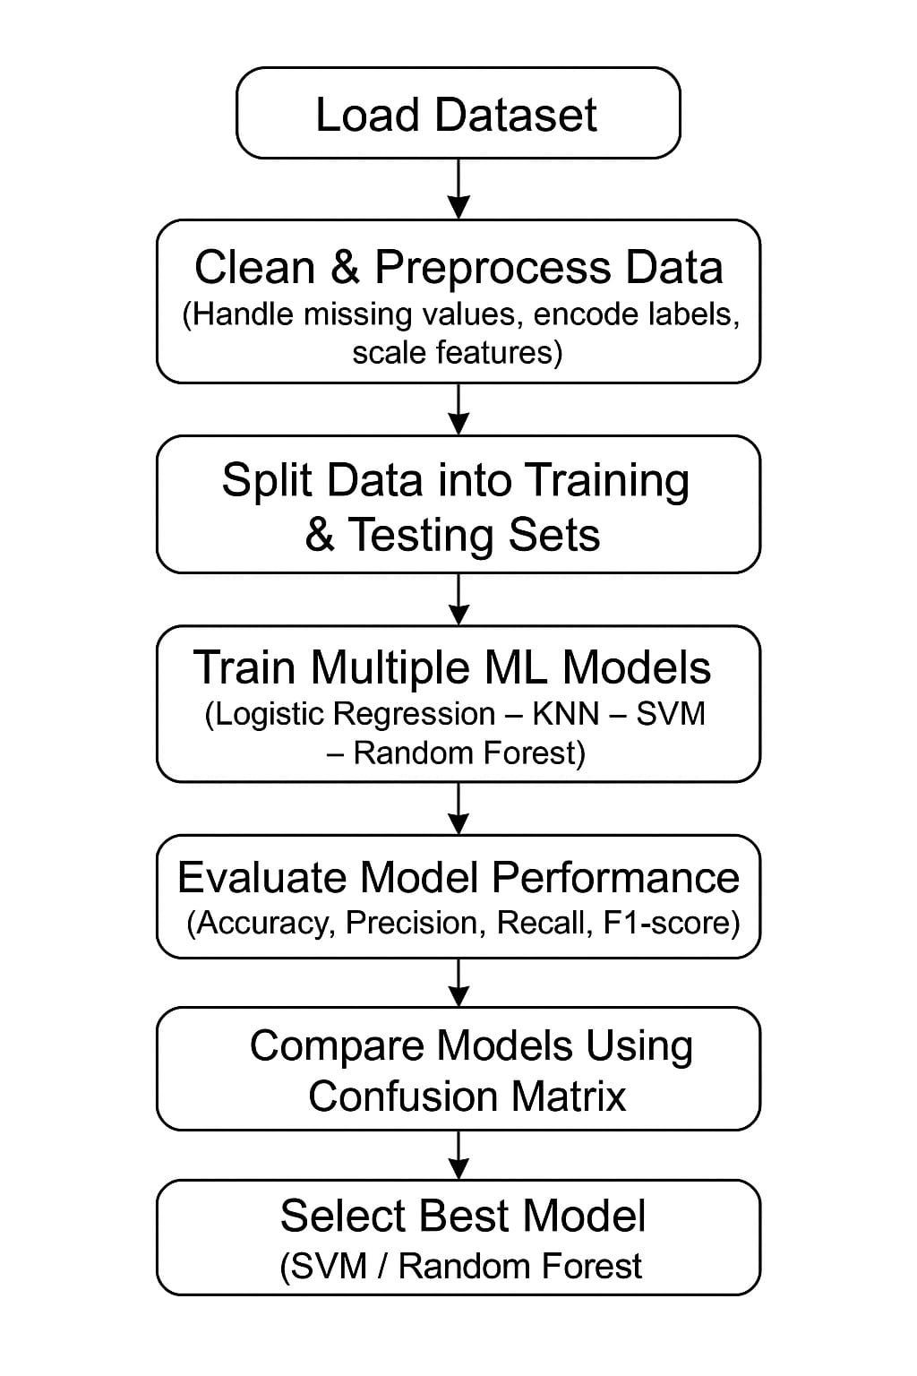
Flowchart

Slide 9

Evaluation Metrics
Accuracy
Measures the overall correctness of the model by calculating how many predictions were right out of all predictions made.
A high accuracy means the model is performing well overall, but it might not be enough alone in medical diagnosis.
Precision
Represents how many of the tumors predicted as malignant were actually malignant.
High precision means the model makes very few false alarms, which is crucial to avoid unnecessary panic or extra medical procedures.
Recall
Indicates how many of the actual malignant cases the model successfully detected.
High recall means the model rarely misses real cancer cases, making it extremely valuable for early detection.
F1-Score
A balanced measure that combines precision and recall into a single number.
It’s especially useful when the dataset is imbalanced.
A strong F1-score means the model is both accurate and reliable in identifying cancer cases.
• Mean Squared Error (MSE):
A metric that measures the average of the squared differences between the actual and predicted values; lower values indicate a more accurate model.
• R² Score:
A metric that represents how much of the variance in the data is explained by the model; values closer to 1 indicate stronger model performance.

Slide 10
Confusion Matrix & Comparison
Confusion Matrix
A confusion matrix is a powerful visual tool that shows exactly how the model performed by comparing predicted labels with actual labels.
It highlights the four key outcomes:
True Positives (TP): Correctly predicted malignant cases.
True Negatives (TN): Correctly predicted benign cases.
False Positives (FP): Benign cases predicted as malignant.
False Negatives (FN): Malignant cases predicted as benign (the most dangerous type).
This helps us understand where the model succeeds and where it makes mistakes.
Model Comparison
By comparing confusion matrices for different models, we can clearly see:
Which model captures malignant cases more accurately
Which model produces fewer false alarms
Which model maintains the best balance between sensitivity and reliability
This comparison makes it easy to choose the most effective and trustworthy model for medical diagnosis.

Slide 11
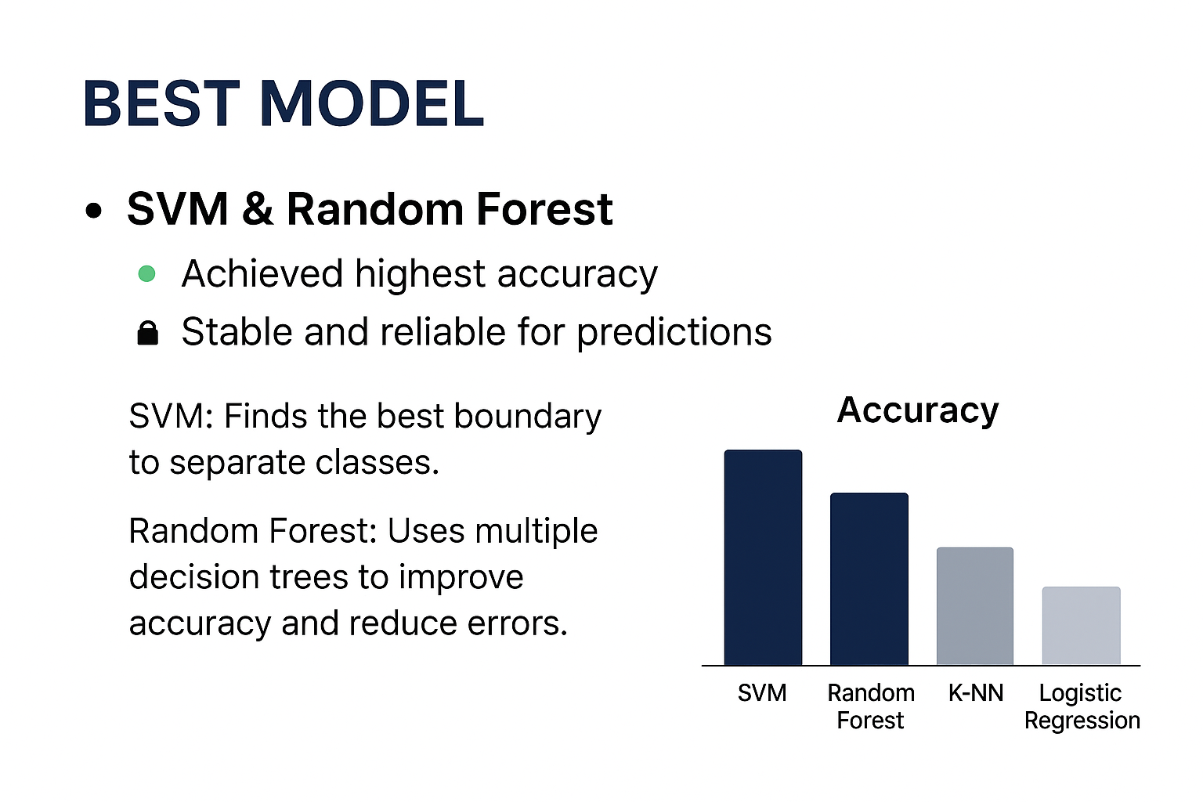
Best Model
.
High accuracy → most predictions are correct.
Stable & reliable → performance remains consistent across different datasets.

Slide 12
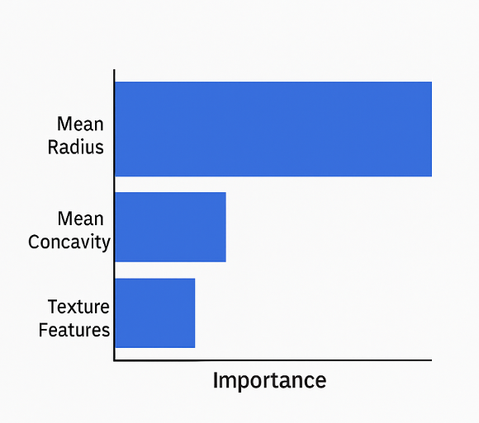
Feature Importance
Mean Radius: One of the most important features for prediction.
Mean Concavity: Helps distinguish malignant from benign tumors.
Texture Features: Provide additional information about cell surface patterns.
Explanation points
Shows which features the model relies on most.
High importance → feature strongly influences model decisions.
Useful for understanding and interpreting predictions in medical diagnosis.

Slide 13
Conclusion
Machine Learning (ML) significantly boosts early detection of breast cancer.
The models achieved high and reliable performance.
This helps speed up medical diagnosis and improve clinical decision accuracy.

Slide 14

References
Kaggle Dataset – Breast cancer dataset used in this project.
Scikit‑Learn Documentation – Official docs for Python ML library.
ChatGPT – Assisted in writing and structuring the presentation content.
This Photo by Unknown Author is licensed under CC BY-SA

Slide 15

دمتم سالمين

